Slide 1
Biology
Sylvia S. Mader
Michael Windelspecht
Chapter 24
Flowering Plants: Structure and Organization
Lecture Outline
See separate FlexArt PowerPoint slides for all figures and tables pre-inserted into PowerPoint without notes.
Copyright 2022 © McGraw Hill LLC. All rights reserved. No reproduction or distribution without the prior written consent of McGraw Hill LLC.

Slide 2
Outline
24.1 Cells and Tissues of Flowering Plants
24.2 Organs of Flowering Plants
24.3 Organization and Diversity of Roots
24.4 Organization and Diversity of Stems
24.5 Organization and Diversity of Leaves

Slide 3
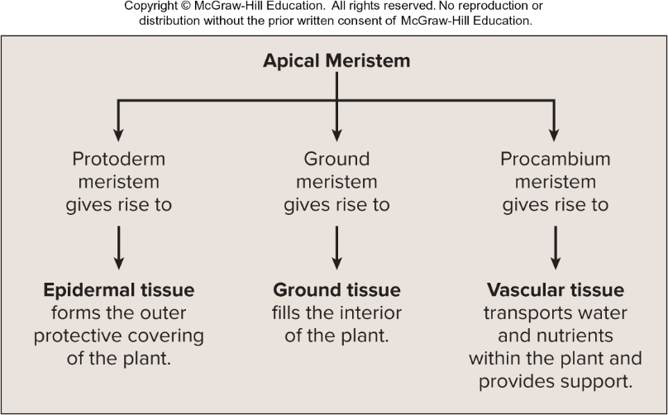
Apical Meristem Gives Rise to Differing Plant Tissues
Access the text alternative for slide images.

Slide 4
24.1 Cells and Tissues of Flowering Plants
As in animals, a cell is the basic unit of life.
A tissue is made of specialized cells that perform a particular function.
An organ is a structure made from multiple tissues.

Slide 5
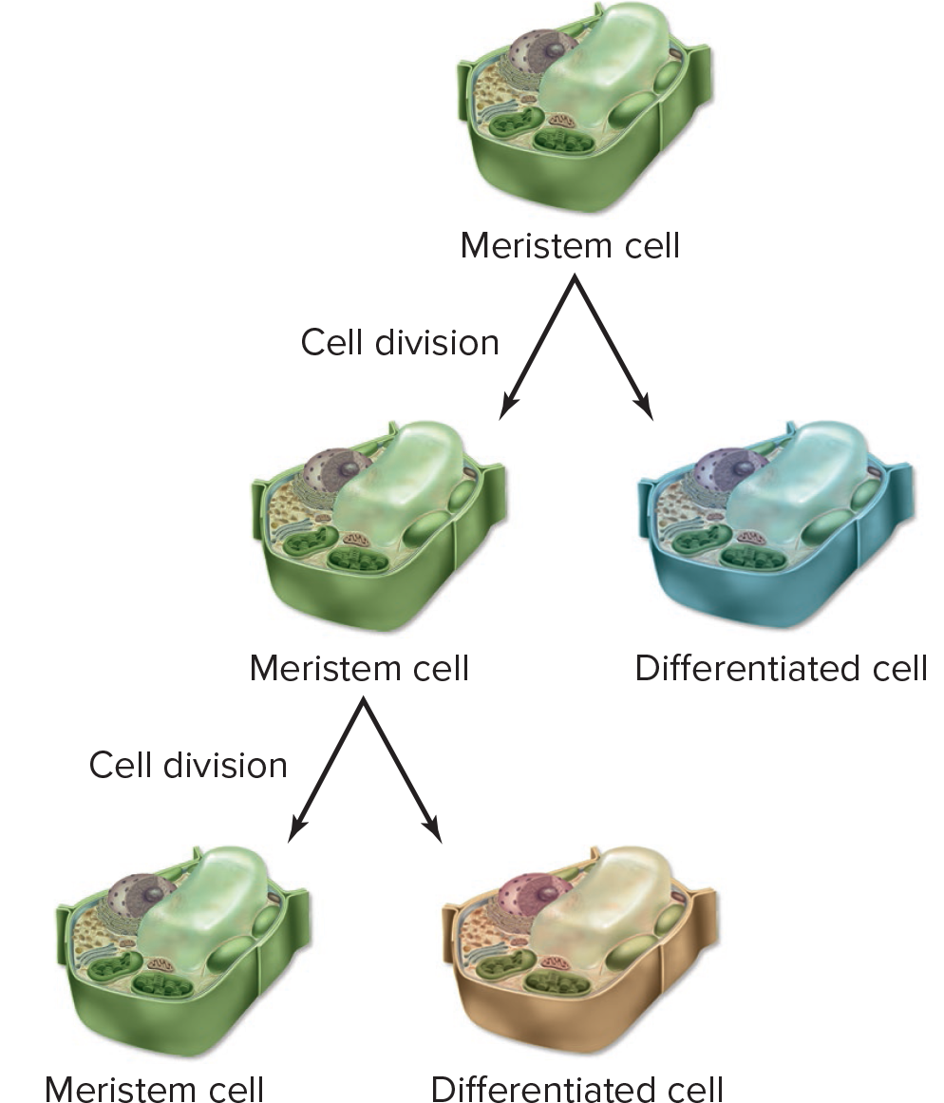
Meristem Cell Division
Figure 24.1

Slide 6
Meristem Development
When a plant embryo first develops, the first cells are called meristem cells.
  Undifferentiated cells able to divide indefinitely and give rise to many types of differentiated cells
Meristematic tissue allows flowering plants to grow throughout their lifetime.
  Apical meristems at the tips of stems and roots increase the length of these tissues.
  Apical meristems produce three types of meristem, which produce three specialized tissues.
    Epidermal tissue
    Ground tissue
    Vascular tissue

Slide 7
Epidermal Tissue 1
  It forms the outer protective covering of a plant.
  Epidermis contains closely packed epidermal cells.
    Epidermal cells exposed to air are covered with waxy cuticle.
    Root epidermal cells have root hairs.
      Increase surface area of root for water absorption

Slide 8
Epidermal Tissue 2
    Epidermal cells of stems, leaves, and reproductive organs have trichomes.
      Protect from sun and moisture loss
      Discourage herbivory
    The lower leaf surface contains stomata.
  In older woody plants, the epidermis of the stem is replaced by periderm.
    Major component is cork
    New cork is made by cork cambium.

Slide 9
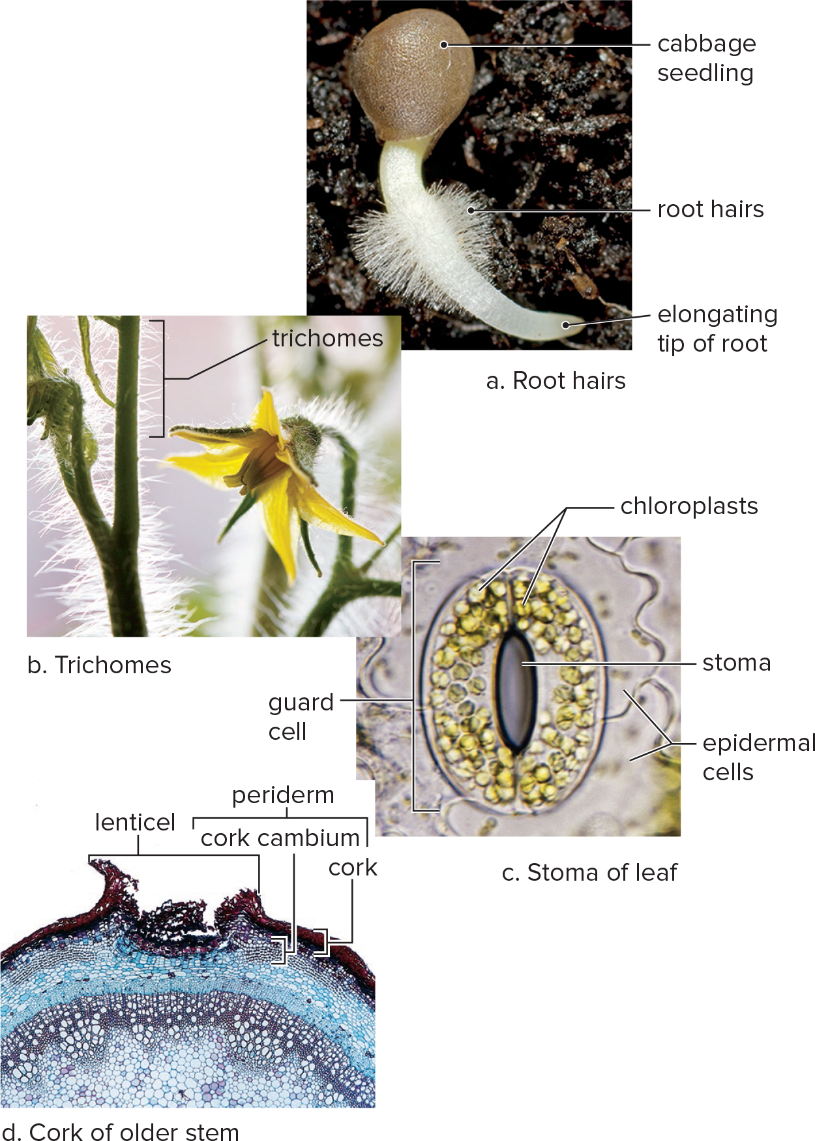
Modifications of Epidermal Tissue
Figure 24.2
Access the text alternative for slide images.
(a): Nigel Cattlin/Alamy Stock Photo; (b): Anthony Pleva/Alamy Stock Photo;
(c): Biophoto Associates/Science Source; (d): Kingsley Stern

Slide 10
Ground Tissue 1
Forms the bulk of a flowering plant
  Parenchyma cells:
    Least specialized and most abundant cells; found in all organs of plant
    Can divide and give rise to more specialized cells
    Contain chloroplasts and perform photosynthesis
  Collenchyma cells:
    Have thicker primary walls
    Form bundles underneath epidermis
    Provide flexible support for immature regions of the plant
      Example: Strands in celery stalks

Slide 11
Ground Tissue 2
  Sclerenchyma cells:
    They have thick secondary walls impregnated with lignin.
    Most are nonliving at maturity
    Primary function is to support mature regions of the plant
    Two types of sclerenchyma cells:
      Fibers – Long, slender, and grouped in bundles (hemp and rope)
      Sclereids – Shorter, more varied (seed coats and nutshells)

Slide 12
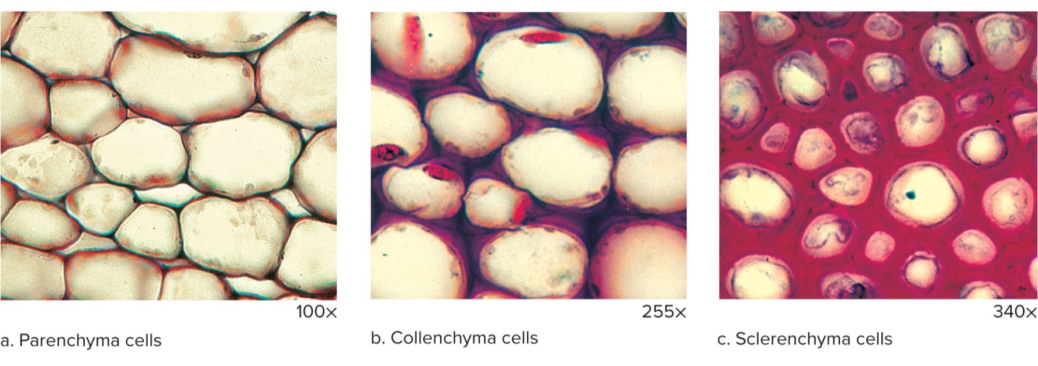
Ground Tissue Cells
Figure 24.3
(all): Biophoto Associates/Science Source

Slide 13
Vascular Tissue
There are two types of vascular tissues in plants, xylem and phloem
    In roots, vascular tissue is located in vascular cylinder
    In stem, forms vascular bundles
    In leaves, found in leaf veins
Xylem:
  Xylem transports water and minerals from the roots to the leaves.
  Xylem contains two types of cells that conduct water: tracheids and vessel elements.
  Phloem:
  Phloem transports sucrose and other organic compounds.

Slide 14
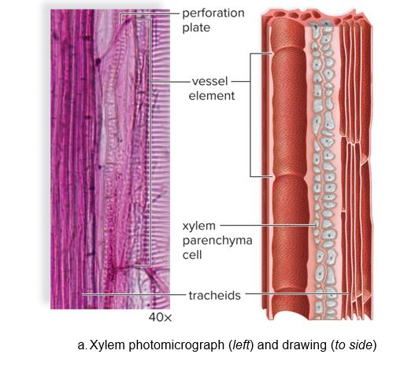
Xylem Structure
Figure 24.4
Access the text alternative for slide images.
(photo): (a): Garry DeLong/Science Source

Slide 15
Tracheids and Vessel Elements
    Tracheids
      They are long with tapered ends.
      Water moves across pits in end walls and side walls.
      Vascular rays between rows of tracheids conduct water across the width of the plant.
    Vessel Elements
      They are larger, with perforation plates in their end walls.
      They form a continuous vessel for water and mineral transport.

Slide 16
Sieve-Tube Members
  Conducting cells of phloem are specialized parenchyma cells.
    Sieve-tube members function as conducting cells.
      Contain cytoplasm, but lack nuclei
      Sieve plate – cluster of pores in wall
    Each sieve-tube member has a companion cell.
      Plasmodesmata connect the two
      Companion cell contains a nucleus
      Involved in transport function

Slide 17
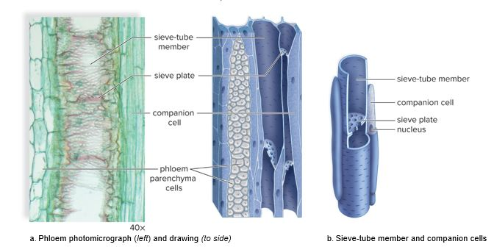
Phloem Structure
Figure 24.5
Access the text alternative for slide images.
(photo): (a): Robert Knauft/Biology Pics/Science Source

Slide 18
24.2 Organs of Flowering Plants
Flowering plants (or angiosperms) are extremely diverse, but share many common structural features.
Vegetative organs are all plant parts except the reproductive structures.
Vegetative organs are concerned with growth and nutrition.
A typical plant features three vegetative organs.
  Roots, stems, and leaves
Most flowering plants possess a root system and a shoot system.
  The root system simply consists of the roots.
  The shoot system consists of the stem and leaves.
Flowers, seeds, and fruits are structures involved in reproduction.

Slide 19
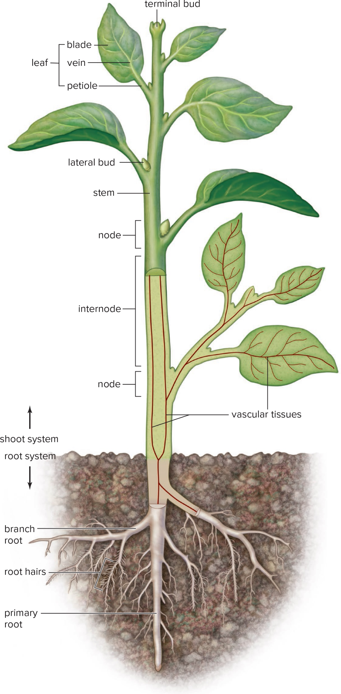
Organization of Plant Body
Figure 24.6
Access the text alternative for slide images.

Slide 20
Shoot System
  Shoot system of a plant is composed of the stem, branches, and leaves.
    Stem is the main axis of a plant that elongates and produces leaves.
      Nodes occur where leaves are attached to the stem.
      Internode is the region between nodes.
      At the stem end, a terminal bud contains an apical meristem and produces new leaves.
    Stem also has vascular tissue that transports water and minerals.

Slide 21
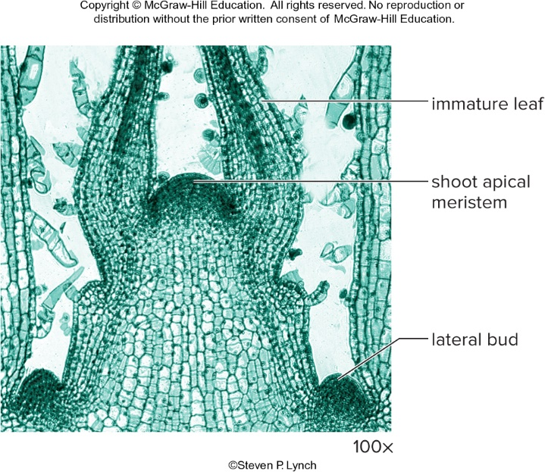
A Terminal Bud
Figure 24.7
Steven P. Lynch

Slide 22
Monocots
Variations of organs and organ systems lead to classification as a monocot or eudicot
Monocots (single cotyledon)
  Cotyledons act as transfer tissue.
    Nutrients are derived from the endosperm.
  Root vascular tissue occurs in a ring.
  Leaves have a parallel venation.
  Flower parts are arranged in multiples of three.

Slide 23
Eudicots
Eudicots (two cotyledons)
  Cotyledons supply nutrients to seedlings.
  Root phloem is located between xylem arms.
  Leaves have a netted venation.
  Flower parts are arranged in multiples of four or five.

Slide 24
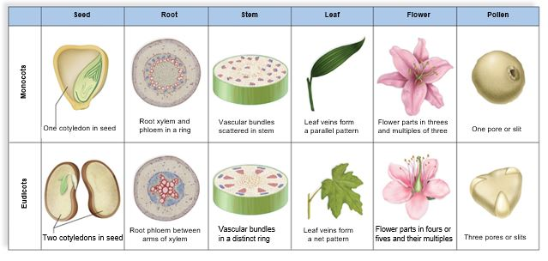
Flowering Plants Are Either Monocots or Eudicots
Figure 24.8
Access the text alternative for slide images.

Slide 25
Vegetative Organs and Plant Life Cycles
  Annual plants live for only one growing season.
    These produce enough vegetative structures to support flower and seeds.
    After seed dispersal, the plant dies.
  Perennial plants live for three or more seasons.
    These spend energy making vegetative structures which help the plant survive for years.
  Flower-inducing genes LEAFY and Apetala 1 are the difference between annuals and perennials.
    They are genetic switches which determine whether a plant is an annual or a perennial.
    Blocking flower-inducing genes in annuals induces perennial growth.

Slide 26
24.3 Organization and Diversity of Roots
In the eudicot root:
  Root cap contains the root apical meristem.
  Zone of cell division contains primary meristems.
  Zone of elongation contains cells that are lengthening and becoming specialized.
  Zone of maturation contains fully differentiated cells.

Slide 27
Tissues of Eudicot Root
  Epidermis – Outer layer of root
  Cortex – Composed of parenchyma cells, allowing water and minerals movement
  Endodermis – Forms a boundary between cortex and inner vascular cylinder
    Casparian strip is composed of protein lignin and suberin.
  Pericycle – Mitotically active and is the starting point for development of branch or lateral roots

Slide 28
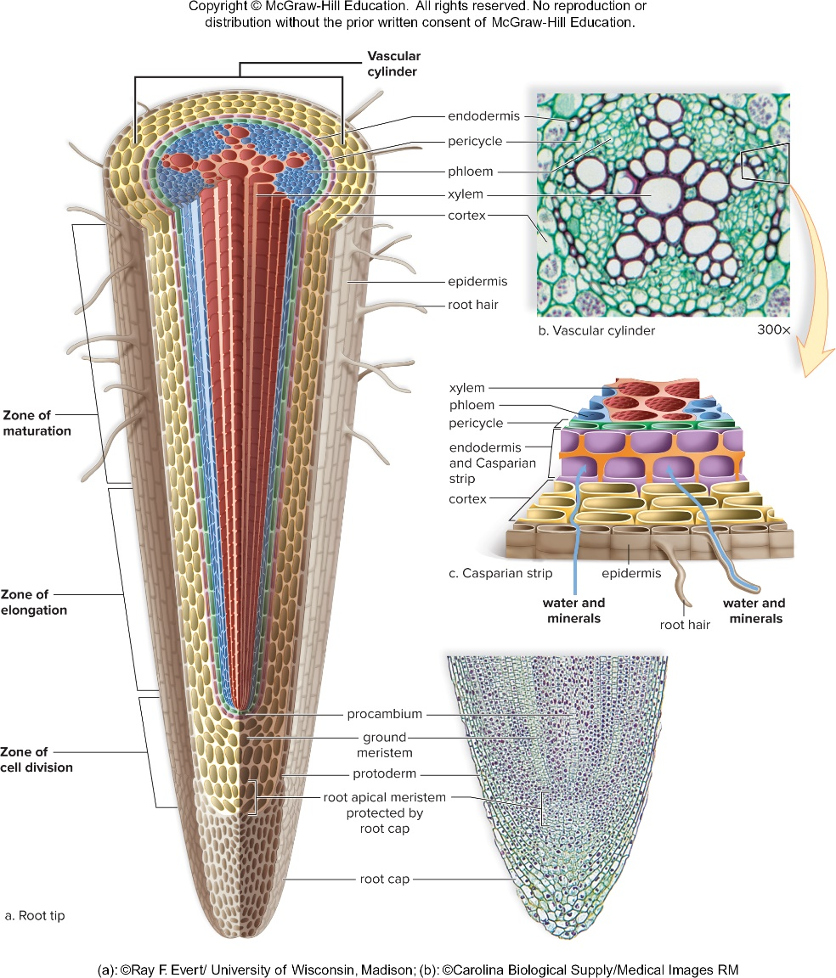
Eudicot Root Tip
Figure 24.9
Access the text alternative for slide images.
(photos): (a): Ray F. Evert/ University of Wisconsin; (b): Carolina Biological Supply/Medical Images

Slide 29
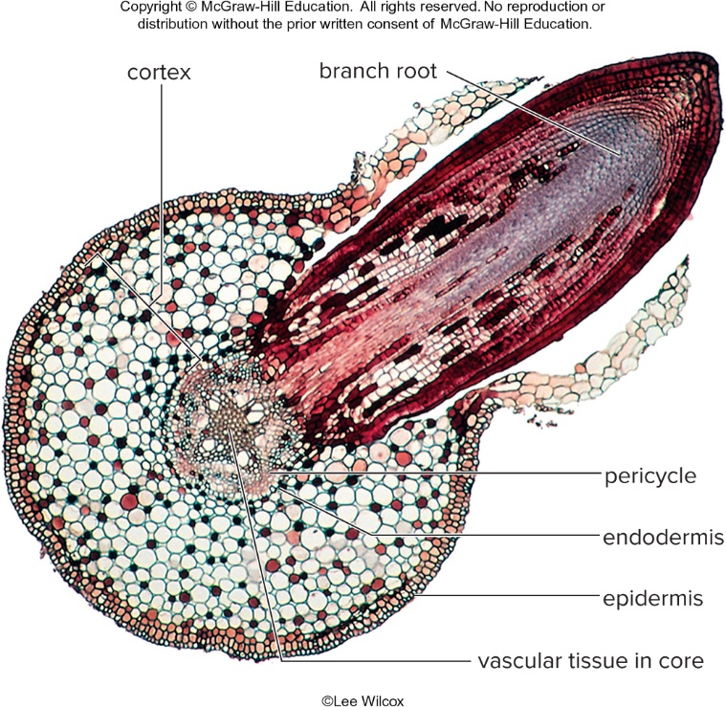
Branching of a Eudicot Root
Figure 24.10

Slide 30
Organization of Monocot Roots
  The ground tissue of root’s pith is surrounded by a vascular ring.
  They have the same growth zones as eudicot roots, but do not undergo secondary growth.
  They have pericycle, endodermis, cortex, and epidermis.

Slide 31
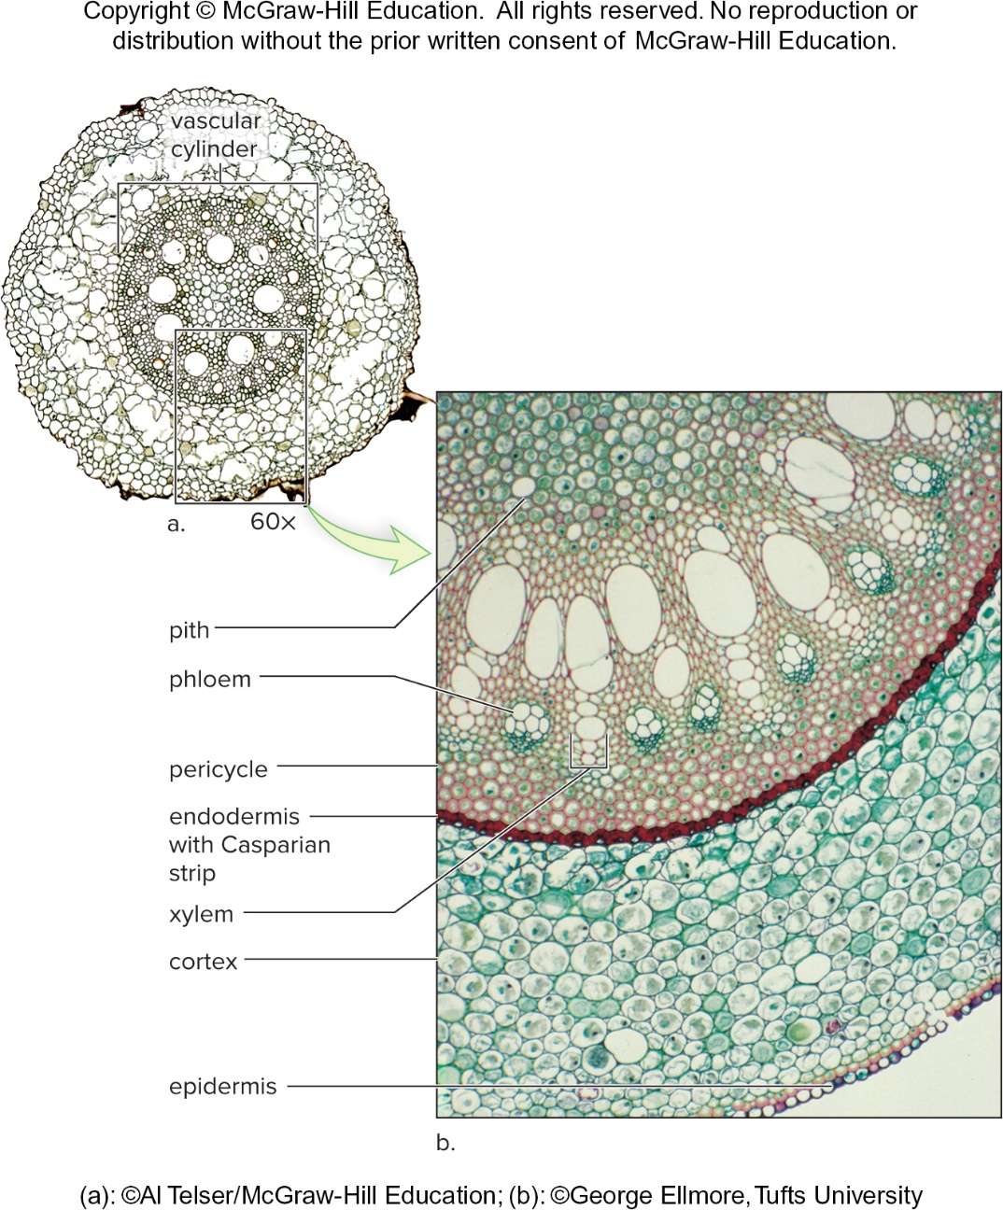
Monocot Root
Figure 24.11
(a): AIvin Telser/McGraw-Hill; (b): ©George Ellmore, Tufts University

Slide 32
Root Diversity
Primary root (taproot) – Fleshy, long single root, that grows straight down
  Stores food
Fibrous root system – Slender roots and lateral branches
  Anchors plant to soil
  Found in monocots
Some plants have roots that possess a variety of adaptations to better perform their functions.
Improve anchorage to the ground and support in high wind
Store large quantities of carbohydrate
Increase absorption of water, minerals, oxygen, sunlight

Slide 33
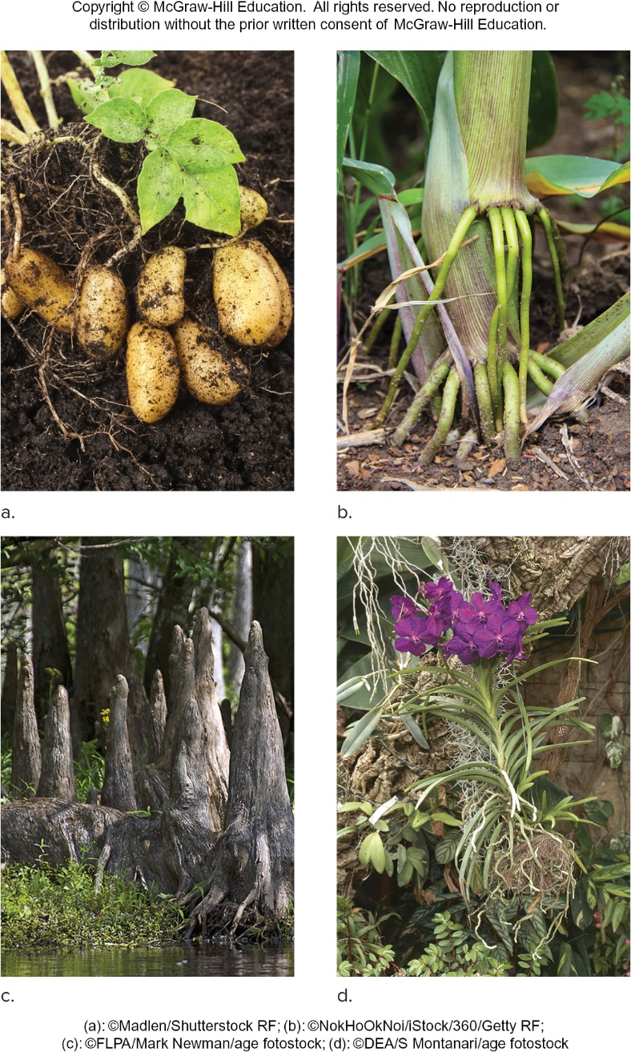
Root Specializations
Figure 24.12
(a): Madlen/Shutterstock; (b): NokHoOkNoi/iStock/Getty Images;
(c): FLPA/Mark Newman/age fotostock; (d): DEA/S Montanari/age fotostock

Slide 34
Root Symbiotic Relationships
  Mycorrhizae:
    Mutualistic associations between roots and fungi
    Assist in water and mineral extraction
  Root nodules:
    Contain nitrogen-fixing bacteria
      Plants cannot extract nitrogen from air, but bacteria in nodules can take up and reduce atmospheric nitrogen.
      Plants get nitrogen from bacteria, which receive carbohydrates from the plant.

Slide 35
24.4 Organization and Diversity of Stems
Anatomy of a woody twig:
  Terminal bud contains the shoot tip protected by bud scales.
    Each spring, bud scales drop, leaving a scar.
    Each scar is one year of growth.
  Shoot apical meristem
    Produces new cells that elongate and increase stem length
    Protected by terminal bud
      Enveloped by leaf primordia
      Specialized primary meristems
        Protoderm – gives rise to the epidermis
        Ground Meristem – gives rise to pith and cortex
        Procambium – produces primary xylem and phloem
    Mature vascular bundles contain vascular cambium.

Slide 36
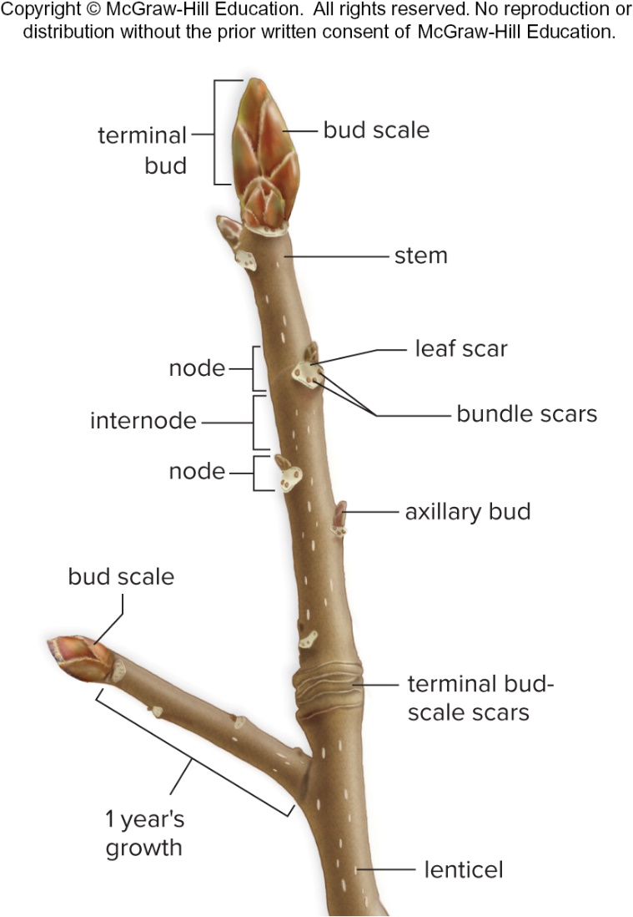
Woody Twig
Figure 24.13

Slide 37
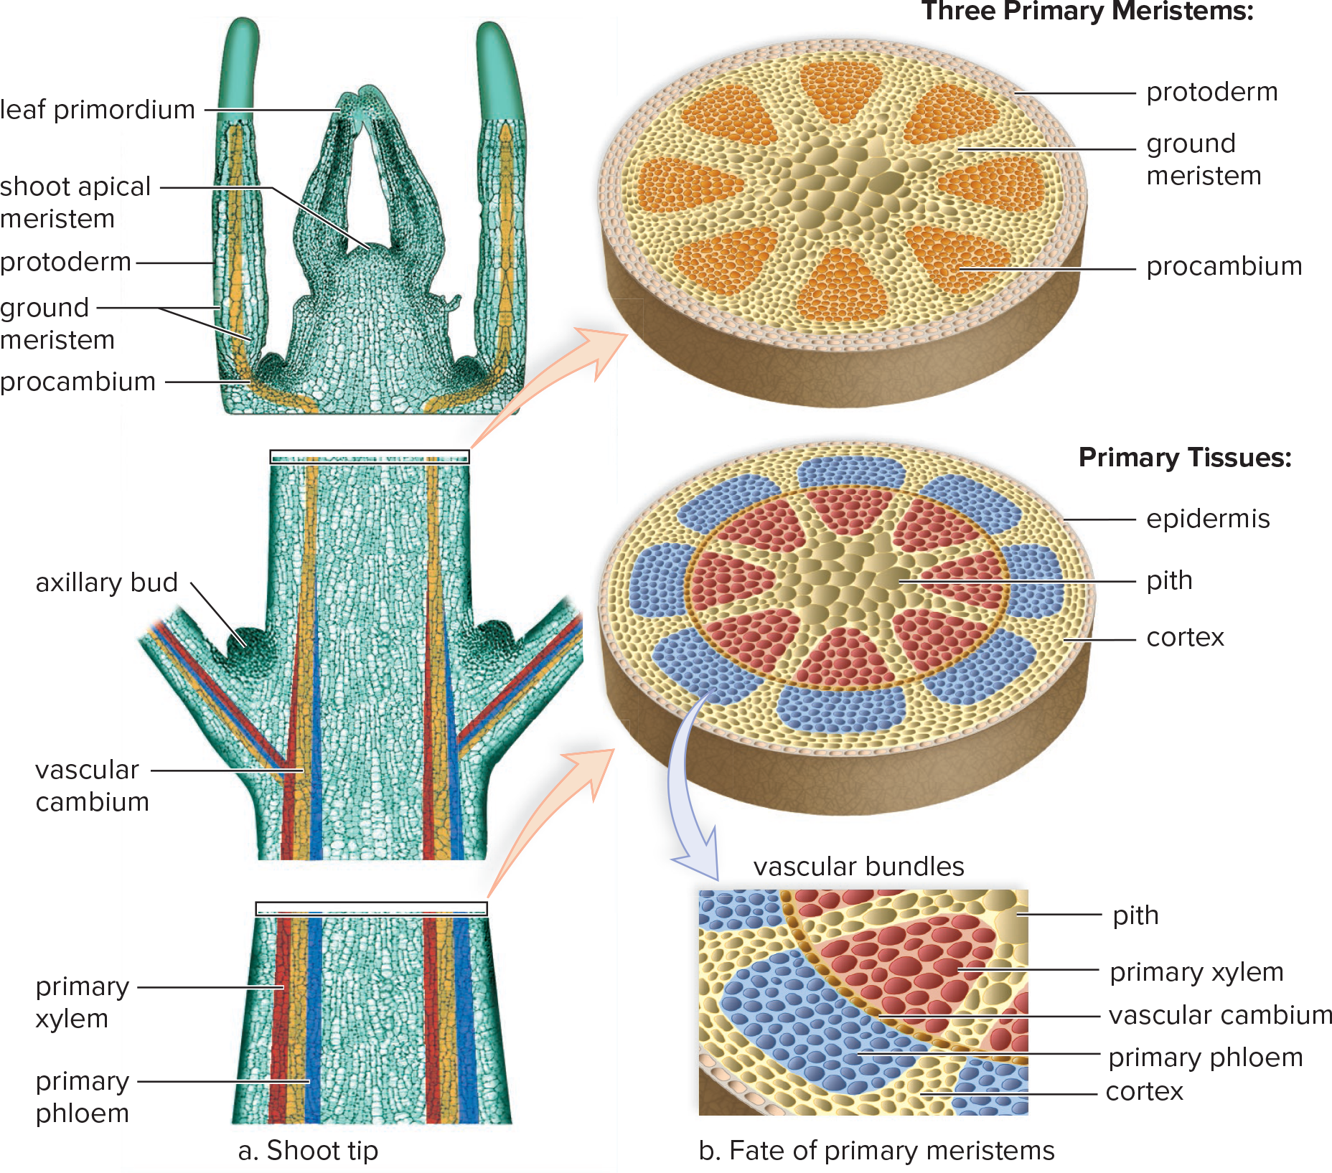
Shoot Tip and Primary Meristems
Figure 24.14
Access the text alternative for slide images.
(a): Steven P. Lynch

Slide 38
Herbaceous Stems
  Mature, nonwoody stems exhibit only primary growth.
    Outermost tissue is covered with waxy cuticle.
    Stems have distinctive vascular bundles.
      Herbaceous eudicots – vascular bundles arranged in distinct ring
      Monocots – vascular bundles scattered throughout stem

Slide 39
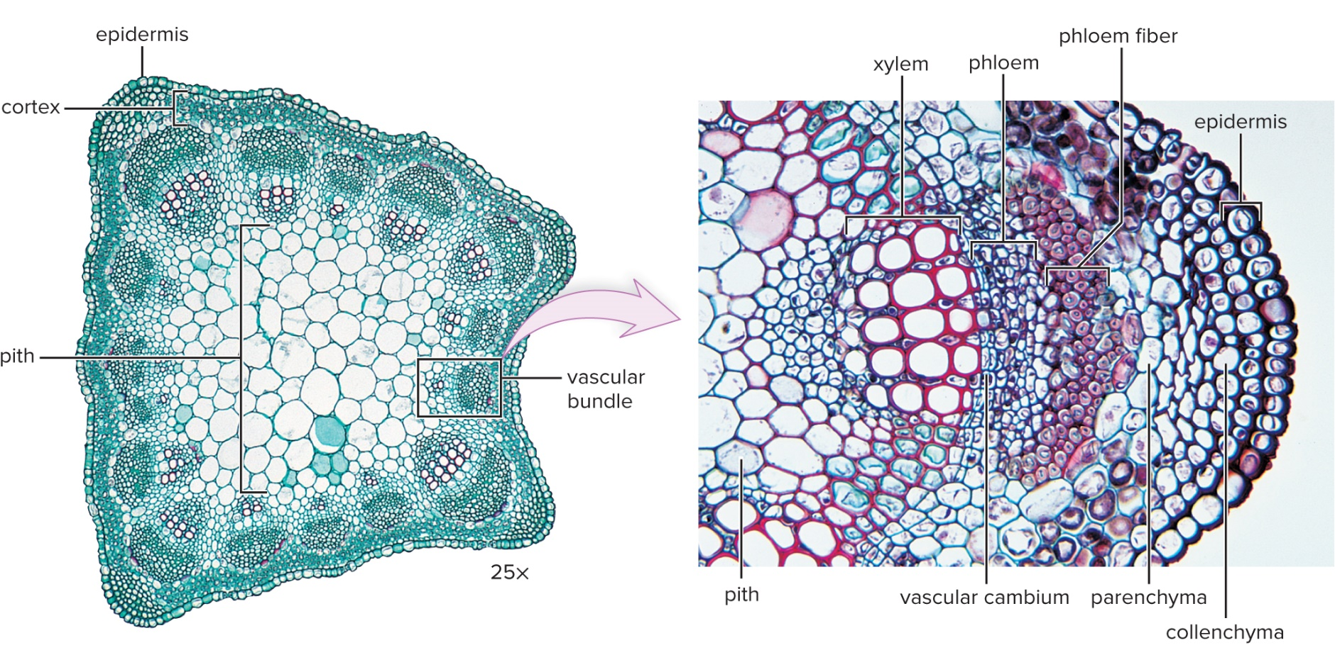
Herbaceous Eudicot Stem
Figure 24.15
Access the text alternative for slide images.
(left): Ed Reschke; (right): Ray F. Evert/University of Wisconsin, Madison

Slide 40
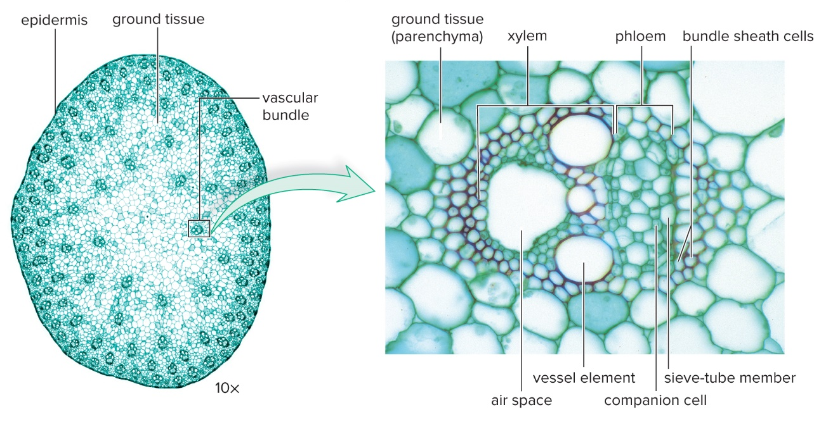
Monocot Stem
Figure 24.16
Access the text alternative for slide images.
(stem cross section): Steven P. Lynch; (enlarged vascular bundle): ©Kingsley Stern

Slide 41
Woody Stems
Woody plants have both primary and secondary tissues.
    Primary tissues form each year from primary meristems.
    Secondary tissues develop during first and subsequent years from lateral meristems.

Slide 42
Woody Stem Characteristics
Woody stems have both primary and secondary growth.
  Primary growth increases the length of the plant.
  Secondary growth increases the girth.
Woody stems have no vascular tissue, and instead have three distinct regions.
  Bark
  Wood
  Pith

Slide 43
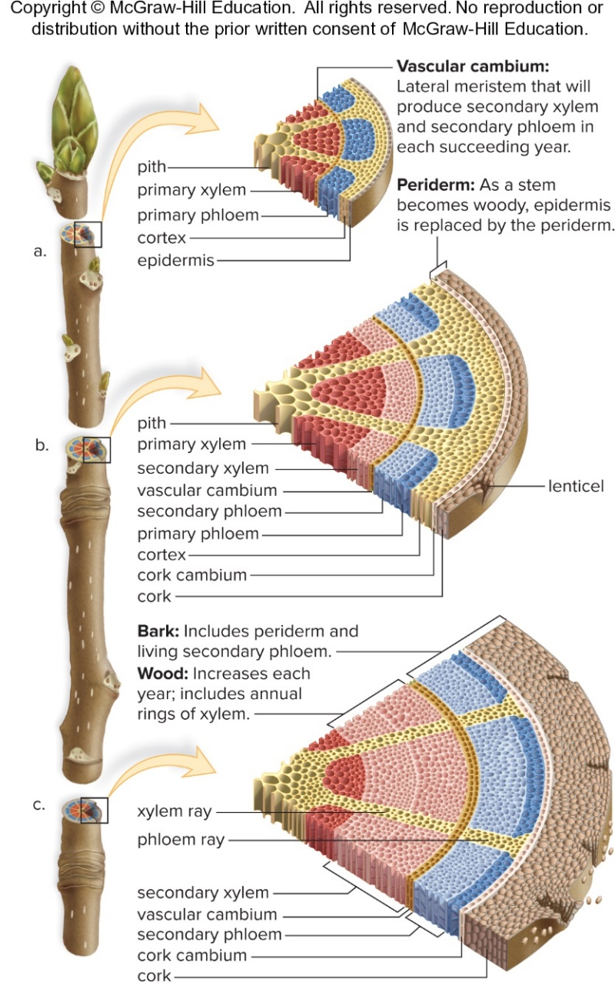
Diagrams of Secondary Growth of Stems
Figure 24.17
Access the text alternative for slide images.

Slide 44
Bark
  Bark of a tree contains cork, cork cambium, cortex, and phloem.
  Bark can be removed, but it is harmful to the plant due to lack of organic nutrient transport.
  Girdling, removing bark from around the tree, leads to the death of the tree.
  Cork cells are impregnated with suberin.
    Gas exchange is impeded except at lenticels.

Slide 45
Wood
  Wood is secondary xylem that builds up year after year.
    Vascular cambium is dormant during winter.
    Annual ring is made up of spring wood and summer wood.
      Summer wood has a lower proportion of vessels than spring wood.
  In older trees, inner annual rings, called heartwood, no longer function in water transport.

Slide 46
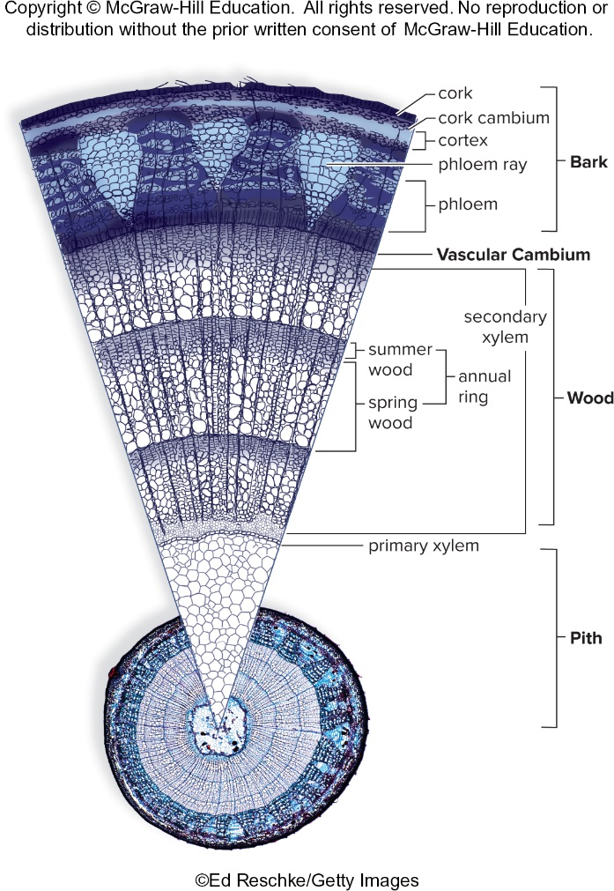
Three-Year-Old Woody Twig
Figure 24.18
Access the text alternative for slide images.
(photo) (circular cross section): Ed Reschke/Stone/Getty Images

Slide 47
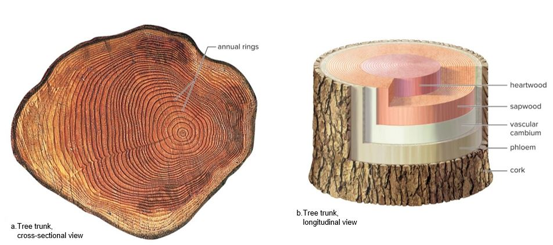
Tree Trunk
Figure 24.19
Access the text alternative for slide images.
(a): Ardea London/Ardea

Slide 48
Stem Diversity 1
  Aboveground vertical stems
  Stolons
    Aboveground horizontal stems
    Produce new plants when nodes touch the ground
  Rhizomes
    Underground horizontal stems
    Contribute to asexual reproduction
    Variations:
      Tubers – Enlarged portions functioning in food storage
      Corms – Underground stems that produce new plants during the next season
  Humans make use of stems.
    Sugar cane produces table sugar.
    Cinnamon and quinine are produced from bark.
    Wood is used to produce paper and building materials.

Slide 49
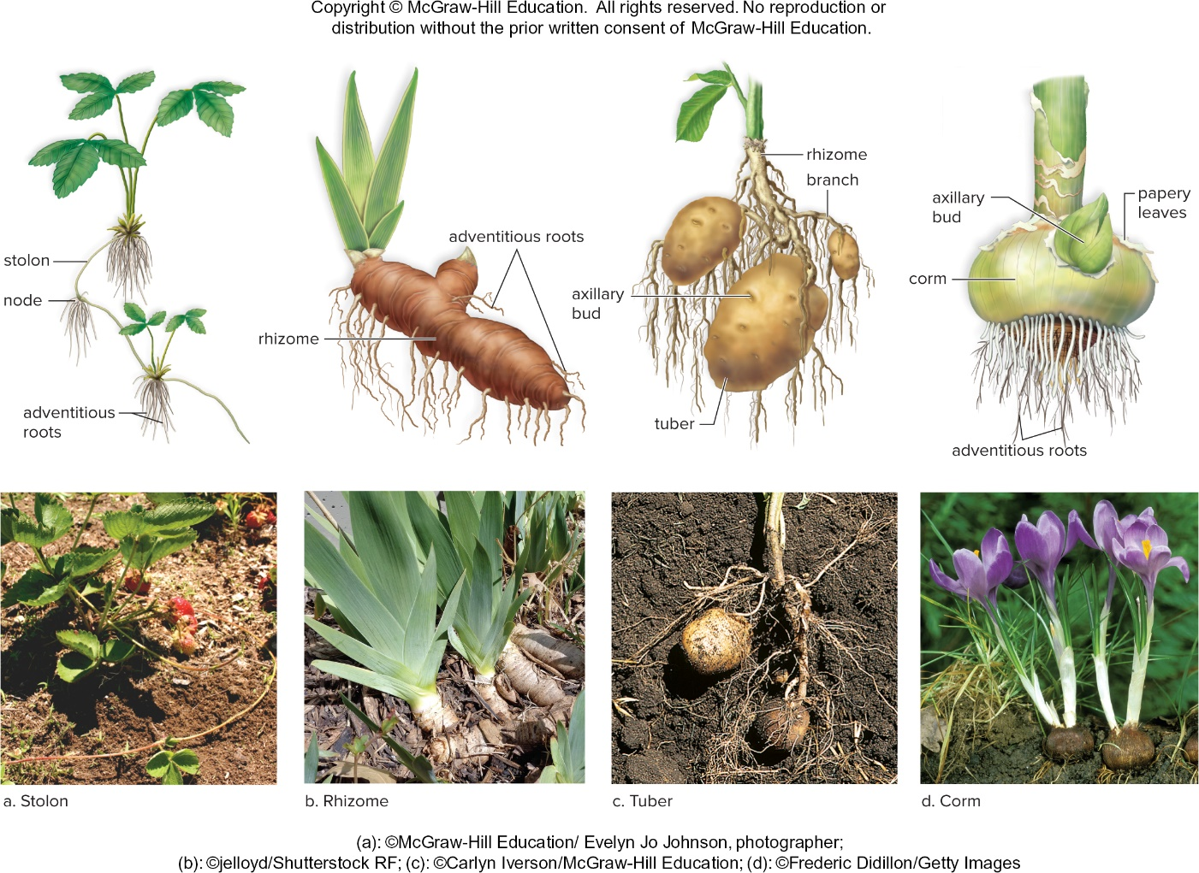
Stem Diversity 2
Figure 24.20
Access the text alternative for slide images.
(photos): (a): Evelyn Jo Johnson/McGraw-Hill;
(b): jelloyd/Shutterstock; (c): Carlyn Iverson/McGraw-Hill; (d): Frederic Didillon/PhotolibraryGetty Images

Slide 50
24.5 Organization and Diversity of Leaves
  The leaf is the major part of the plant that carries on photosynthesis.
    Photosynthesis requires water, carbon dioxide, and sun.
  Foliage leaves are usually broad and thin.
      Blade – Wide portion of foliage leaf
      Petiole – Stalk attaching blade to stem
      Leaf axil – Upper acute angle between petiole and stem where the axillary bud is found
Sizes, shapes, colors, and textures of leaves are variable.
    Evergreens bear leaves the entire year.
    Plants that lose all of their leaves are deciduous.

Slide 51
Leaf Morphology
Leaves contain:
  Upper and lower epidermis
    Waxy cuticle
    Trichomes
    Lower epidermis has stomata for gas exchange.
  Mesophyll
    Eudicot leaves have:
      Palisade mesophyll containing elongated cells
      Spongy mesophyll containing irregular cells bounded by air spaces
    Contains many chloroplasts

Slide 52
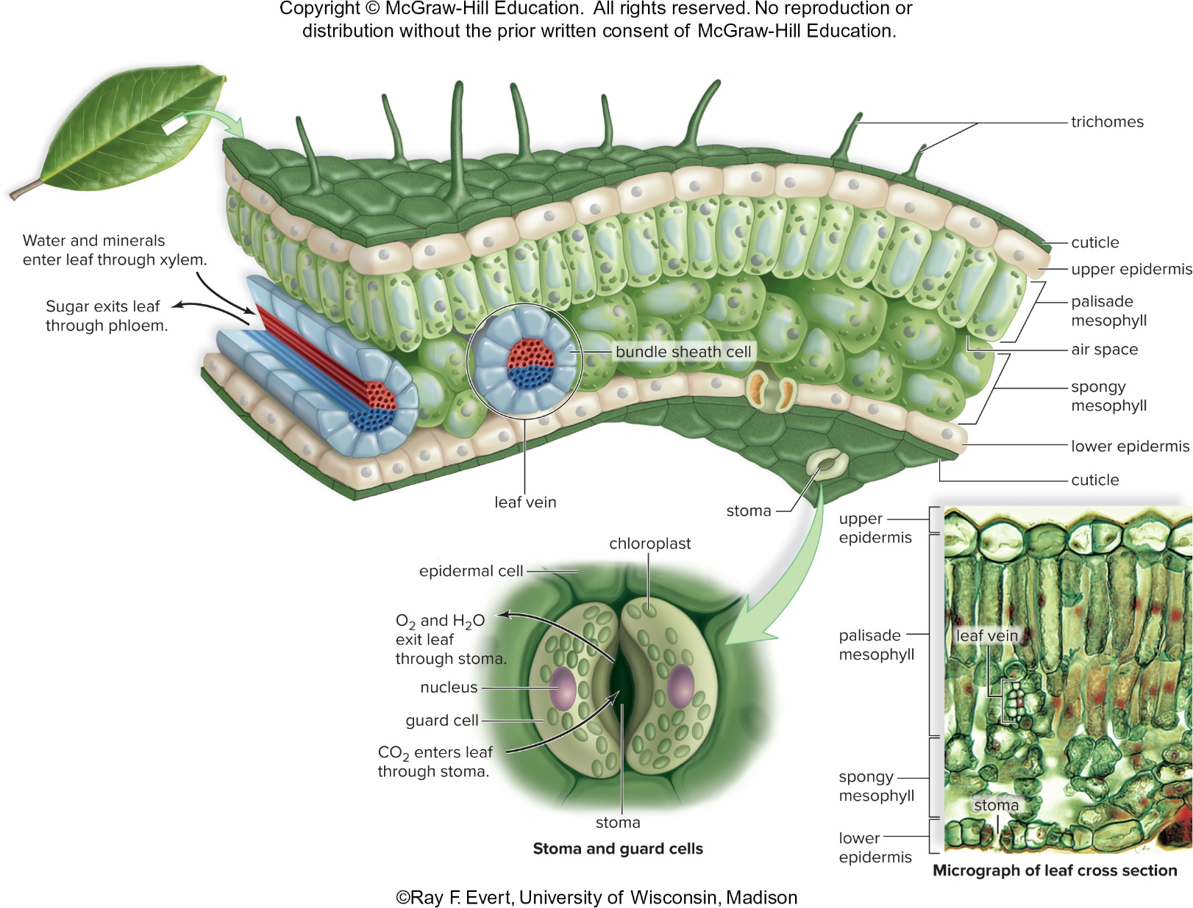
Leaf Structure
Figure 24.22
Access the text alternative for slide images.
(photo): Ray F. Evert, University of Wisconsin

Slide 53
Diversity of Leaves
  Leaves can be arranged on the stem as alternate, opposite, or whorled.
  Blade (wide portion) of a leaf can be simple or compound.
  Leaves are adapted to environmental conditions.
    Shade leaves
    Spines
    Climbing leaves (modified tendrils)
    Reduced leaves
  Some plants are specialized for catching insects.
    Sundew
    Venus flytrap

Slide 54
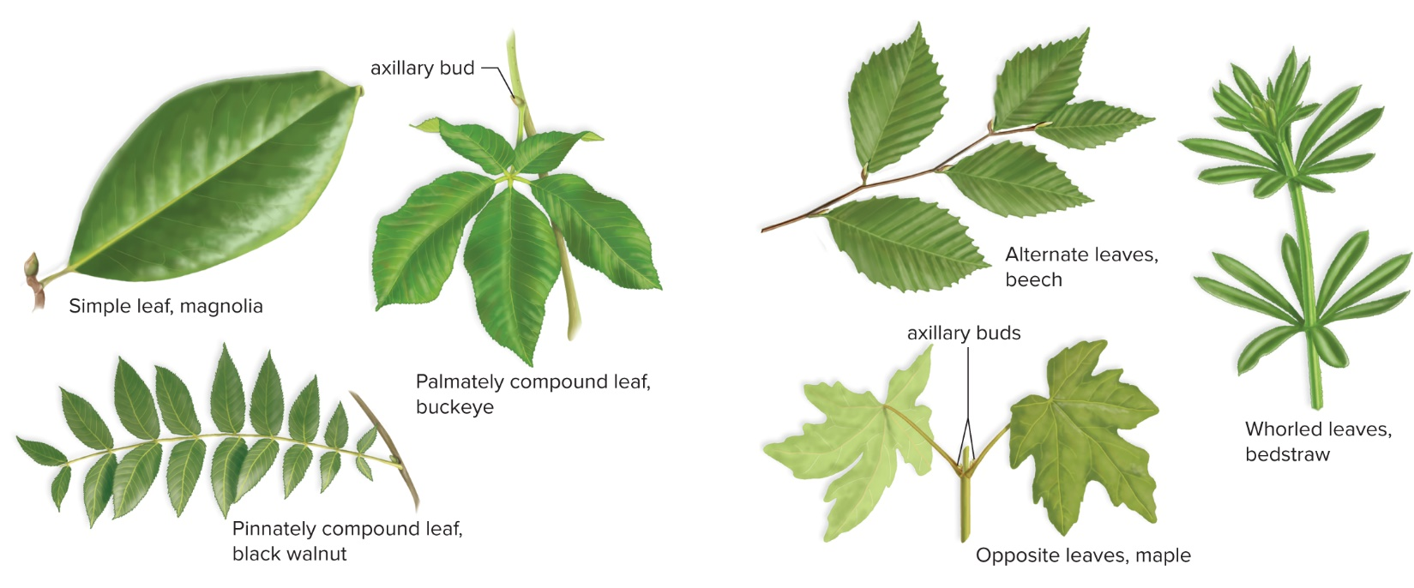
Classification of Leaves
Simple versus compound leaves
Arrangement of leaves on stem
Figure 24.23
Access the text alternative for slide images.

Slide 55
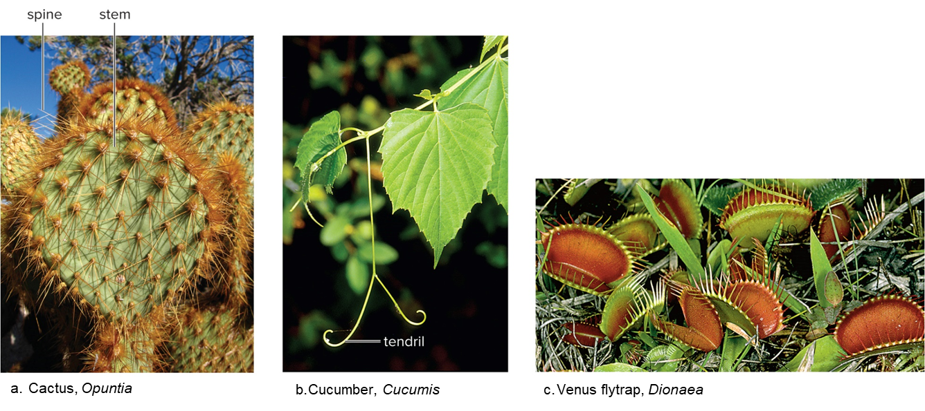
Leaf Diversity
Figure 24.24
(a): NPS Photo by Robb Hannawacker;; (b, c): Steven P. Lynch

Slide 56
End of main content
Copyright 2022 © McGraw Hill LLC. All rights reserved. No reproduction or distribution without the prior written consent of McGraw Hill LLC.

Slide 57
Accessibility Content: Text Alternatives for Images

Slide 58
Apical Meristem Gives Rise to Differing Plant Tissues - Text Alternative
Return to parent-slide containing images.
Apical Meristem: Protoderm meristem gives rise to epidermal tissue, which forms the outer protective covering of the plant. Ground meristem gives rise to ground tissue, which fills the interior of the plant. Procambium meristem gives rise to vascular tissue, which transports water and nutrients within the plant and provides support.
Return to parent-slide containing images.

Slide 59
Modifications of Epidermal Tissue - Text Alternative
Return to parent-slide containing images.
a) Root hairs shows label for cabbage seedling, root hairs, and elongating tip of root.
B) Trichomes.
C) Stoma of leaf shows a guard cell containing chloroplasts, stoma, and epidermal cells.
D) Labels include lenticel and periderm where periderm includes alternate arrangement of cork, cambium, and cork.
Return to parent-slide containing images.

Slide 60
Xylem Structure - Text Alternative
Return to parent-slide containing images.
A) Xylem photomicrograph (left) and drawing (to side):
Micrograph and diagram shows longitudinal tracheids, irregularly ovular xylem parenchyma cell, vessel element and perforation plate.
B) Two types of vessels:
Diagrams show pits on the outside and perforation plate on the inside with vessel element.
C) Tracheids:
It shows pitted walls and tracheid on the outside.
Return to parent-slide containing images.

Slide 61
Phloem Structure - Text Alternative
Return to parent-slide containing images.
A) Phloem photomicrograph (left) and drawing (to side):
Micrograph and diagram shows irregularly ovular phloem parenchyma cells, longitudinal companion cell, sieve plate and sieve-tube member in the center.
B) Sieve-tube member and companion cells:
Diagrams show sieve-tube member and sieve plate on the inside and companion cell with nucleus on the outside.
Return to parent-slide containing images.

Slide 62
Organization of Plant Body - Text Alternative
Return to parent-slide containing images.
The root system consists of branch root, root hairs and primary root.
The shoot system consists of vascular tissues, nodes, internode, stem, lateral bud, leaf (consisting of blade, vein and petiole) and terminal bud.
Return to parent-slide containing images.

Slide 63
Flowering Plants Are Either Monocots or Eudicots - Text Alternative
Return to parent-slide containing images.
Monocots: one cotyledon in seed, root xylem and phloem in a ring; vascular bundles scattered in stem; leaf veins form a parallel pattern; flower parts in threes and multiples of three; one pore or slit (pollen). Eudicots: two cotyledons in seed; root phloem between arms of xylem; vascular bundles in a distinct ring; leaf veins form a net pattern; flower parts in fours or fives and their multiples; three pores or slits (pollen).
Return to parent-slide containing images.

Slide 64
Eudicot Root Tip - Text Alternative
Return to parent-slide containing images.
A) Root tip:
Diagram of root tips divides into zone of cell division, zone of elongation, zone of maturation and vascular cylinder on the top.
Micrograph of zone of cell division shows multiple procambium, ground meristem, protoderm, root apical meristem protected by root cap and root cap.
B) Vascular cylinder:
Micrograph of vascular cylinder shows multiple circular endodermis, pericycle, phloem, large circular xylem in center and circular cortex, with epidermis and root hair.
C) Casparian strip:
Diagram shows layers of xylem, phloem, pericycle, endodermis and Casparian strip, cortex and epidermis with root hair (from where water and minerals flow in and out).
Return to parent-slide containing images.

Slide 65
Shoot Tip and Primary Meristems - Text Alternative
Return to parent-slide containing images.
A) Shoot tip:
Diagram of shoot tips divides into three zones.
Lower zone:
It consists of longitudinal primary xylem and primary phloem.
Middle zone:
It consists of longitudinal vascular cambium and hemispherical axillary bud.
Top zone:
It consists of procambium, ground meristem, protoderm, shoot apical meristem and leaf primordium.
B) Fate of primary meristems:
Three Primary Meristems:
It consists of protoderm on the outer radial area, ground meristem in the middle and procambium in the core.
C) Primary Tissues:
It consists of epidermis on the outermost radial area, cortex in the outer radial area and pith in the center.
Enlarged diagram of vascular bundles show circular multiple pith, primary xylem, vascular cambium, primary phloem and cortex.
Return to parent-slide containing images.

Slide 66
Herbaceous Eudicot Stem - Text Alternative
Return to parent-slide containing images.
Left panel:
Diagram of herbaceous eudicot stem consists of cluster of pith in the center with cortex and epidermis.
Right panel:
Enlarged diagram of vascular bundles show circular multiple xylem, phloem, phloem fiber, circular pith, vascular cambium with set layers of parenchyma cells, collenchyma cells, and epidermis.
Return to parent-slide containing images.

Slide 67
Monocot Stem - Text Alternative
Return to parent-slide containing images.
Top panel:
Micrograph shows ovular vascular bundles, ground tissue and epidermis.
Right panel:
Enlarged diagram of vascular bundle shows different sized circular layers of ground tissue (parenchyma), xylem, phloem, bundle sheath cells, sieve-tube member, air space, companion cell, and vessel element.
Return to parent-slide containing images.

Slide 68
Diagrams of Secondary Growth of Stems - Text Alternative
Return to parent-slide containing images.
Vascular cambium: lateral meristem that will produce secondary xylem and secondary phloem in each succeeding year. Periderm: As a stem becomes woody, epidermis is replaced by the periderm. Bark: includes periderm and living secondary phloem. Wood: Increases each year; includes annual rings of xylem.
Return to parent-slide containing images.

Slide 69
Three-Year-Old Woody Twig - Text Alternative
Return to parent-slide containing images.
Pith:
it consists of layer of primary xylem.
Wood:
It consists of layers of summer and spring wood (which together constitute annual
ring) and secondary xylem.
Vascular Cambium.
Bark:
It consists of layers of phloem, phloem ray, cortex, cork cambium and cork.
Return to parent-slide containing images.

Slide 70
Tree Trunk - Text Alternative
Return to parent-slide containing images.
A) Tree trunk, cross-sectional view:
Diagram shows irregular circular annual rings across the surface.
B) Tree trunk, longitudinal view:
It consists of inner to outer layers of heartwood, sapwood, vascular cambium, phloem and cork.
Return to parent-slide containing images.

Slide 71
Stem Diversity 2 - Text Alternative
Return to parent-slide containing images.
a) Labels include stolon, node, and adventitious roots.
B) Labels include rhizone and adventitious roots.
C) Labels on potato include rhizome, branch, axillary bud, and tuber.
D) Labels of gladiolus include axillary bud, corm, papery leaves, and adventitious roots.
Return to parent-slide containing images.

Slide 72
Leaf Structure - Text Alternative
Return to parent-slide containing images.
Lateral diagram of leaf shows projections of trichomes, with layers of cuticle, upper epidermis, palisade mesophyll, air space, spongy mesophyll, lower epidermis and cuticle with stoma and leaf vein. Water and minerals enter leaf through xylem while the
sugar exits leaf through phloem.
Diagram of stoma and guard cells show multiple ovular chloroplasts, guard cell, nucleus, epidermal cell with oxygen and water exiting leaf through stoma and carbon dioxide leaving leaf through stoma.
Micrograph of leaf cross section shows layers of upper epidermis, palisade mesophyll, spongy mesophyll and lower epidermis with stoma gaps and cluster of leaf veins.
Return to parent-slide containing images.

Slide 73
Classification of Leaves - Text Alternative
Return to parent-slide containing images.
a) Simple leaf, magnolia; palmately compound leaf, buckeye showing label for axillary bud; and pinnately compound leaf, black walnut.
b) Alternate leaves, beech; whorled leaves, bedstraw; and opposite leaves, maple.
Return to parent-slide containing images.

